Slide 1
CS 484
Introduction to Machine Learning
Week 8, March 4, 2021
Spring Semester 2021

Slide 2
Week 8: Learner Evaluation
Numeric Metrics
Visual Metrics

Slide 3
Metrics for Evaluation and Comparison
Statistics
Originated from statistical literature
Statistics: Root Mean Squared Errors, R-squared, Entropy and Gini
Binary Target
Originated from engineering literature for binary target
Receiver Operating Characteristic (ROC) charts, Area Under Curve, Confusion Matrix, Misclassification Rate, Root Mean Squared Errors, Root Average Squared Errors
Focus Group
Originated from direct marketing for target market segment
Lift and Gain Measures, Precision and Recall measures
Information Theory: Akaike's Information Criterion (AIC) and Bayesian Information Criterion (BIC)

Slide 4
Metrics for Evaluation and Comparison
Target
Binary
Visual Metric
Numeric Metric
Interval
Numeric Metric
Nominal
Numeric Metric

Slide 5
Metrics for Interval Target
We aim to reduce the RASE or the relative error, but not all the way to zero.
If the RASE or the relative error is 0, then $y_{i}={\hat{y}}_{i}$ and the model has been overfitted.
If the relative error is 1, then predicted target value is practically same as observed mean.
We aim to reduce the RASE or the relative error, but not all the way to zero.
If the RASE or the relative error is 0, then 𝑦_𝑖=𝑦 ̂_𝑖 and the model has been overfitted.
If the relative error is 1, then predicted target value is practically same as observed mean.
Root Average Squared Error (RASE) = $\sqrt{\frac{1}{n}\sum_{i=1}^{n}{{\left(y_{i}−{\hat{y}}_{i}\right)}^{2}}}$
$y_{i}$ is the observed target value ${\hat{y}}_{i}$ is the predicted target value $n$ is the number of observations
Root Average Squared Error (RASE) = √(1/𝑛 ∑_(𝑖=1)^𝑛▒(𝑦_𝑖−𝑦 ̂_𝑖 )^2 )
𝑦_𝑖 is the observed target value 𝑦 ̂_𝑖 is the predicted target value 𝑛 is the number of observations
Relative Error = $\frac{\sum_{i=1}^{n}{{\left(y_{i}−{\hat{y}}_{i}\right)}^{2}}}{\sum_{i=1}^{n}{{\left(y_{i}−\overline{y}\right)}^{2}}}$
$\overline{y}$ is the observed target mean
Relative Error = (∑_(𝑖=1)^𝑛▒(𝑦_𝑖−𝑦 ̂_𝑖 )^2 )/(∑_(𝑖=1)^𝑛▒(𝑦_𝑖−𝑦 ̅ )^2 )
𝑦 ̅ is the observed target mean

Slide 6
Metrics for Binary Target Variable
Misclassification Rate
Area Under Curve (of Receiver Operating Characteristics)
Root Averaged Squared Error
Gini Coefficient
Goodman-Kruskal Gamma
Kolmogorov-Smirnov statistic

Slide 7
Binary Target Variable
Values are labelled Event and Non-Event
The classification model produces predicted probability for Event and predicted probability for Non-Event
Observed Target is Non-Event Predicted probabilities for Event are: $\left\{p_{k0}:k=1,…, n_{NE}\right\}$
Observed Target is Non-Event Predicted probabilities for Event are: {𝑝_𝑘0:𝑘=1,…, 𝑛_𝑁𝐸 }
Observed Target is Event Predicted probabilities for Event are: $\left\{p_{l1}:l=1,…, n_{E}\right\}$
Observed Target is Event Predicted probabilities for Event are: {𝑝_𝑙1:𝑙=1,…, 𝑛_𝐸 }

Slide 8
Misclassification Rate
Let 0 ≤ t ≤ 1 be the specified threshold
Observed Non-Event
If $p_{k0}≥t$, then predicted target is Event
If 𝑝_𝑘0≥𝑡, then predicted target is Event
If $p_{k0}<t$, then predicted target is Non-Event
If 𝑝_𝑘0<𝑡, then predicted target is Non-Event
Observed Event
If $p_{l1}≥t$, then predicted target is Event
If 𝑝_𝑙1≥𝑡, then predicted target is Event
If $p_{l1}<t$, then predicted target is Non-Event
If 𝑝_𝑙1<𝑡, then predicted target is Non-Event

Slide 9
Misclassification Rate
An observation is misclassified if the observed target value is not equal to the predicted target value
For a binary target, the conditions for misclassification are:
Observed Target = Event & Predicted Target = Non-Event
Observed Target = Non-Event & Predicted Target = Event
Misclassification Rate = (Number of misclassified observations) / (Number of observations)
Accuracy = 1 – Misclassification Rate
Express Accuracy and Misclassification Rate either as a fraction or as a percentage

Slide 10
Misclassification Rate
A common choice for threshold 0 ≤ t ≤ 1
The observed proportion of a particular target category in the training partition or in the entire data
The uninformative value of (k – 1) / k where k is the number of target categories

Slide 11
Misclassification Rate for Binary Target
We often use the uninformative threshold 0.5
Common Wisdom
Traditionally, we determine the predicted category without explicitly using any threshold.
Predicted Event
If the predicted probability for Event is greater than or equal to the predicted probability for Non-Event
Predicted Non-Event
If the predicted probability for Event is less than the predicted probability for Non-Event

Slide 12

Binary Target Confusion Matrix
Misclassification Rate = (FP + FN) / (TP + FN + FP + TN)
True Positive Rate: Sensitivity = TP / (TP + FN)
True Negative Rate: Specificity = TN / (FP + TN)
Observed | Predicted
 | Event | Non-Event
Event | True Positive (TP) | False Negative (FN)
Non-Event | False Positive (FP) | True Negative (TN)

Slide 13
Misclassification Rate
Confusion Matrix
Observed | Predicted
 | Event | Non-Event
Event | 4 | 2
Non-Event | 2 | 3
Use the Uninformative Threshold of 0.5
Predicted Event if Predicted Event Probability ≥ 0.5
Number of observations is 11
Number of Misclassified observations is 4
Sensitivity = 4 / 6 = 66.67%
Specificity = 3 / 5 = 60%
Misclassification Rate = 4 / 11 = 36.36%
Observed Target Value | Predicted Event Probability | Prediction | Misclassified?
Event | 0.3 | Non-Event | 1
Event | 0.4 | Non-Event | 1
Event | 0.5 | Event | 0
Event | 0.7 | Event | 0
Event | 0.9 | Event | 0
Event | 1 | Event | 0
Non-Event | 0.2 | Non-Event | 0
Non-Event | 0.3 | Non-Event | 0
Non-Event | 0.3 | Non-Event | 0
Non-Event | 0.5 | Event | 1
Non-Event | 0.8 | Event | 1

Slide 14
Area Under Curve (AUC)
Sort the predicted probabilities:
Event: $p_{11}≤ ⋯≤p_{n_{E}1}$
Non-Event: $p_{10}≤ ⋯≤p_{n_{NE}0}$
Create a two-way table
Row dimension: $p_{11}≤ ⋯≤p_{n_{E}1}$
Column dimension: $p_{10}≤ ⋯≤p_{n_{NE}0}$
Each cell in the table corresponds to a pair of predicted probabilities: $\left(p_{l1},p_{k0}\right)$
Number of pairs (or cells) is $n_{E}×n_{NE}$
 | $$p_{10}$$ | ≤ … | $$p_{k0}$$ | ≤ … | $$p_{n_{NE}0}$$
$$p_{11}$$
≤ …
$$p_{l1}$$
≤ …
$$p_{n_{E}1}$$

Slide 15
Area Under Curve (AUC)
In the perfect scenario, event observations always have higher predicted probabilities than that of non-event observations
This means $p_{l1}>p_{k0}$ for any pair of indices $\left(k,l\right)$.
There is an obvious boundary between the two sets of predicted probabilities
In the worst scenario, event observations always have lower predicted probabilities than that of non-event observations
This means $p_{l1}<p_{k0}$ for any pair of indices $\left(k,l\right)$.
The model predicts the incorrect outcome most, if not always, of the time
Area Under Curve is a metric that measures how close the model to the ideal scenario or how far away from the worst scenario.

Slide 16
Area Under Curve (AUC): Algorithm
$$p_{11}$$ | $$E_{11}$$
: : | : :
$$p_{n_{E}1}$$ | $$E_{n_{E}1}$$
Consider all possible pairs of indices (𝑘,𝑙).
Aggregate the Event observations by their predicted probabilities $p_{11}≤ ⋯≤p_{n_{E}1}$ into a table.
Aggregate the Non-Event observations by their predicted probabilities $p_{10}≤ ⋯≤p_{n_{NE}0}$ into another table.
Perform a Cartesian or full join of the two tables. The resulting table should have $n_{E}×n_{NE}$ records. The cell contents are $E_{11}{NE}_{10}$, …, $E_{n_{E}1}{NE}_{n_{NE}0}$. These represent the number of original observations for each pair of indices (𝑘,𝑙).
$$p_{10}$$ | $${NE}_{10}$$
: : | : :
$$p_{n_{NE}0}$$ | $${NE}_{n_{NE}0}$$

Slide 17
Area Under Curve (AUC): Algorithm
Calculate the number of:
Concordant Pairs where event observation’s predicted probability is greater than that of non-event observation, i.e., $p_{l1}>p_{k0}$
Discordant Pairs where event observation’s predicted probability is less than that of non-event observation, i.e., $p_{l1}<p_{k0}$
Tied Pairs where event observation’s predicted probability is equal to that of non-event observation, i.e., $p_{l1}=p_{k0}$
AUC = 0.5 + 0.5 * (#Concordant Pairs - #Discordant Pairs) / #Pairs
#Pairs = #Concordant Pairs + #Discordant Pairs + #Tied Pairs

Slide 18
Area Under Curve (AUC): Example
Observed Target Value | Predicted Event Probability
Event | 0.9
Non-Event | 0.5
Non-Event | 0.3
Event | 0.7
Event | 0.3
Non-Event | 0.8
Event | 0.4
Non-Event | 0.2
Event | 1.0
Event | 0.5
Non-Event | 0.3
The target is a binary variable
The target values are Event and Non-Event.
The table (on the left) contains the observed target value and the predicted event probabilities.

Slide 19
Area Under Curve (AUC): Example
Observed Target Value | Predicted Event Probability
Event | 0.3
Event | 0.4
Event | 0.5
Event | 0.7
Event | 0.9
Event | 1.0
Non-Event | 0.2
Non-Event | 0.3
Non-Event | 0.3
Non-Event | 0.5
Non-Event | 0.8
Group the predicted probabilities into Event and Non-Event groups
Sort the predicted probabilities in ascending order within each group
Notice the ties?

Slide 20
Area Under Curve (AUC): Example
Predicted Event Probability |  | Observed Non-Event
 |  | 0.2 | 0.3 | 0.3 | 0.5 | 0.8
Observed Event | 0.3 | C | T | T | D | D
 | 0.4 | C | C | C | D | D
 | 0.5 | C | C | C | T | D
 | 0.7 | C | C | C | C | D
 | 0.9 | C | C | C | C | C
 | 1 | C | C | C | C | C
Define the pairs as Concordant (C), Discordant (D), and Tied (T) pairs
Count the numbers of each type of pair

Slide 21
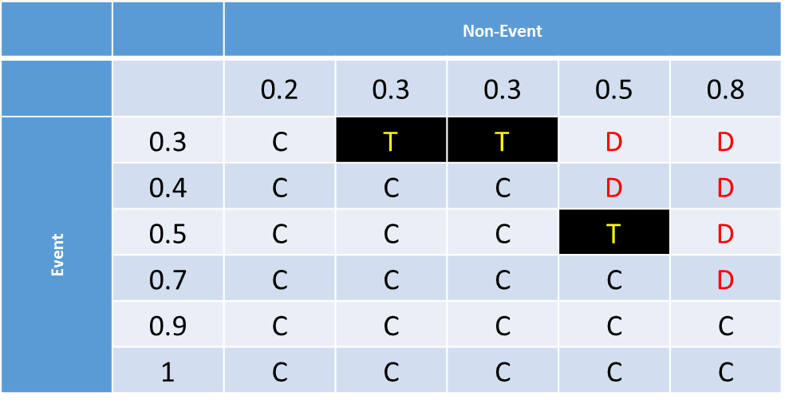
Area Under Curve (AUC): Example
Number of pairs = 6 x 5 = 30
Number of concordant (C) pairs is 21
Number of discordant (D) pairs is 6
Number of ties (T) pairs is 3
The Area Under Curve metric = 0.5 + 0.5 x (21 – 6) / 30 = 0.5 + 0.5 x 0.5 = 0.75

Slide 22
Area Under Curve (AUC)
Perfect scenario: every pair is a concordant pair
#Concordant Pairs = #Pairs, #Discordant Pairs = 0, and #Tied Pairs = 0.
AUC = 0.5 + 0.5 * (#Concordant Pairs - 0) / #Pairs = 0.5 + 0.5 = 1.
E.g., a tree where each terminal node contains one observation (i.e., $p_{k0}=0$ and $p_{l1}=1$)
Worst scenario: every pair is a discordant pair
#Concordant Pairs = 0, #Discordant Pairs = #Pairs, and #Tied Pairs = 0.
AUC = 0.5 + 0.5 * (0 - #Discordant Pairs) / #Pairs = 0.5 – 0.5 = 0.
E.g., we mistakenly misspecified the non-event category as the event.

Slide 23
Area Under Curve (AUC)
Inconclusive Scenario
Either every pair is a tied pair, AUC = 0.5 + 0.5 * (0 – 0) / #Pairs = 0.5
Or #Concordant Pairs = #Discordant Pairs, AUC = 0.5 + 0.5 * 0 = 0.5
E.g., an intercept only model where all predicted probabilities are equal for event and non-event observations.
Acceptable model: AUC > 0.5
Higher the AUC above 0.5, better the model.

Slide 24
Area Under Curve (AUC)
Pros
Does not require a threshold that predicts an observation as Event versus Non-Event
The AUC value is between 0 and 1 and a reference value of 0.5
Cons
Uses only the relative order of predicted probabilities and ignores the actual values
Summarizes model performance over intervals of probabilities which are mediocre values, e.g. [0.3, 0.7]

Slide 25
Gini Coefficient
# Pairs = # Concordant + # Discordant + # Tied
Gini Coefficient = (# Concordant - # Discordant) / # Pairs
Gini = 2 * AUC - 1
Perfect scenario: every pair is a concordant pair ➔ Gini = 1
Worst scenario: every pair is a discordant pair ➔Gini = -1
Inconclusive Scenario: # Concordant = # Discordant ➔ Gini = 0
Acceptable model: Gini > 0
Higher the Gini above 0, better the model

Slide 26
Goodman-Kruskal Gamma
Goodman-Kruskal Gamma = (# Concordant - # Discordant) / (#Concordant + #Discordant)
Perfect scenario: every pair is a concordant pair ➔ Gamma = 1
Worst scenario: every pair is a discordant pair ➔Gamma = -1
Inconclusive Scenario: # Concordant = # Discordant ➔ Gamma = 0
Acceptable model: Gamma > 0
Higher the Gamma above 0, better the model

Slide 27
Gini and Gamma: Example
Number of concordant (C) pairs is 21
Number of discordant (D) pairs is 6
Number of ties (T) pairs is 3
Gini = (21 – 6) / (21 + 6 + 3) = 15 / 30 = 0.5
Gamma = (21 – 6) / (21 + 6) = 15 / 27 = 0.5556

Slide 28
Can $p_{l1}>p_{k0}$ for any (𝑘,𝑙) guarantee a perfect predicted outcome?
3 Event Obs.,
3 Non-Event Obs.
Model A: $p_{l1}=0.53, 0.52, 0.51$ and $p_{k0}=0.49, 0.48, 0.47$
Model B: $p_{l1}=0.99, 0.98, 0.97$ and $p_{k0}=0.03, 0.02, 0.01$
Area Under Curve
Both models’ AUCs are one
Model B is clearly preferred
Predict Event if $p>0.95$
Predict Event if 𝑝>0.95
Model A will predict a non-event for all observations
Misclassification Rate Model A: 50% Model B: 0%
Predict Event if $p>0.05$
Predict Event if 𝑝>0.05
Model A will predict an event for all observations
Misclassification Rate Model A: 50% Model B: 0%

Slide 29
Root Average Squared Error (RASE): Rationale
If a model fits the data well, then we anticipate the predicted event probabilities to be:
Closer to 1 when the observed target value is an Event
Closer to 0 when the observed target value is a Non-Event
Therefore we will derive a metric that shows how close, on average, the predicted event probabilities are to their respective anticipated values.

Slide 30
Root Average Squared Error (RASE): Algorithm
(Average Squared Error) ASE = $\frac{\sum_{l=1}^{n_{E}}{{\left({1 − p}_{l1}\right)}^{2} + \sum_{k=1}^{n_{NE}}{{\left(0−p_{k0}\right)}^{2}}}}{n_{E} +{ n}_{NE}}$
RASE = $\sqrt{ASE}$
Theoretical range of RASE:
The minimum value is zero when $p_{l1}=1$ and $p_{k0}=0$ (perfect model)
The maximum value is one when $p_{l1}=0$ and $p_{k0}=1$ (worst model)
The middle value is 0.5 when $p_{l1}=0.5$ and $p_{k0}=0.5$ (inconclusive model)
Acceptable model: RASE < 0.5
Smaller the RASE below 0.5, better the model.

Slide 31
Root Average Squared Error (RASE)
Consider two models:
Model A: $p_{l1}=0.53, 0.52, 0.51$ and $p_{k0}=0.49, 0.48, 0.47$
Model B: $p_{l1}=0.95, 0.94, 0.93$ and $p_{k0}=0.03, 0.02, 0.01$
RASE of Model A is $\sqrt{\frac{{\left(1−0.53\right)}^{2}+{\left(1−0.52\right)}^{2}+{\left(1−0.51\right)}^{2}+{\left(0−0.49\right)}^{2}+{\left(0−0.48\right)}^{2}+{\left(0−0.47\right)}^{2}}{3+3}}=0.4801$
RASE of Model B is $\sqrt{\frac{{\left(1−0.95\right)}^{2}+{\left(1−0.94\right)}^{2}+{\left(1−0.93\right)}^{2}+{\left(0−0.03\right)}^{2}+{\left(0−0.02\right)}^{2}+{\left(0−0.01\right)}^{2}}{3+3}}=0.0455$
Both models’ AUCs are one, but Model B is clearly preferred because its RASE is about one-tenth of that Model A.

Slide 32
Root Average Squared Error (RASE): Example
The Error is (δ - predicted probability)
δ = 1 for observed Event
δ = 0 for observed Non-Event
The Sum of Squared Error is 2.31
Number of observations is 11
RASE = $\sqrt{{2.31}/{11}}=\sqrt{0.21}$ = 0.4582576 (7 decimals)
Observed Target Value | Predicted Event Probability | Error | Squared Error
Event | 0.3 | 0.7 | 0.49
Event | 0.4 | 0.6 | 0.36
Event | 0.5 | 0.5 | 0.25
Event | 0.7 | 0.3 | 0.09
Event | 0.9 | 0.1 | 0.01
Event | 1 | 0 | 0
Non-Event | 0.2 | -0.2 | 0.04
Non-Event | 0.3 | -0.3 | 0.09
Non-Event | 0.3 | -0.3 | 0.09
Non-Event | 0.5 | -0.5 | 0.25
Non-Event | 0.8 | -0.8 | 0.64
 |  | Total | 2.31

Slide 33
Model Assessment Example
import matplotlib.pyplot as plt
import numpy
import sklearn.metrics as metrics
Y = numpy.array(['Event',
'Non-Event',
'Non-Event',
'Event',
'Event',
'Non-Event',
'Event',
'Non-Event',
'Event',
'Event',
'Non-Event'])
predProbY = numpy.array([0.9,0.5,0.3,0.7,0.3,0.8,0.4,0.2,1,0.5,0.3])

Slide 34
Model Assessment Example
# Determine the predicted class of Y
predY = numpy.where(predProbY >= 0.5, 'Event', 'Non-Event')
# Calculate the Root Average Squared Error
Y_true = numpy.where(Y == 'Event', 1.0, 0.0)
ASE = numpy.mean(numpy.power(Y_true - predProbY, 2))
RASE = numpy.sqrt(ASE)
# Calculate the Root Mean Squared Error
RMSE = metrics.mean_squared_error(Y_true, predProbY)
RMSE = numpy.sqrt(RMSE)
# For binary y_true, y_score is supposed to be the score of the class with greater label.
AUC = metrics.roc_auc_score(Y_true, predProbY)
accuracy = metrics.accuracy_score(Y, predY)
Make ‘Event’ into True and finally to 1.
Otherwise, into False and finally to 0.

Slide 35
Model Assessment Example
print(' Accuracy: {:.13f}' .format(accuracy))
print(' Misclassification Rate: {:.13f}' .format(1-accuracy))
print(' Area Under Curve: {:.13f}' .format(AUC))
print('Root Average Squared Error: {:.13f}' .format(RASE))
print(' Root Mean Squared Error: {:.13f}' .format(RMSE))
------ Results ------
Accuracy: 0.6363636363636
Misclassification Rate: 0.3636363636364
Area Under Curve: 0.7500000000000
Root Average Squared Error: 0.4582575694956
Root Mean Squared Error: 0.4582575694956
Q: Where are Gini Coefficient and Goodman and Krushal Gamma?
A: Write your code to calculate them

Slide 36
Model Assessment Example
Observed Target Value | Predicted Event Probability
Event | 0.9
Non-Event | 0.5
Non-Event | 0.3
Event | 0.7
Event | 0.3
Non-Event | 0.8
Event | 0.4
Non-Event | 0.2
Event | 1.0
Event | 0.5
Non-Event | 0.3
Performance Metrics
AUC = 0.75 > 0.5
RASE = 0.4582576 < 0.5
Misclassification Rate = 0.3636363 < 0.5 (for threshold = 0.5 and 0.54)
Gini = 0.5 > 0
Gamma = 0.5556 > 0
Based on these five metrics, the model fits the data adequately

Slide 37
Common Metric for Nominal Target
Area Under Curve
Root Average Squared Error
Misclassification Rate

Slide 38
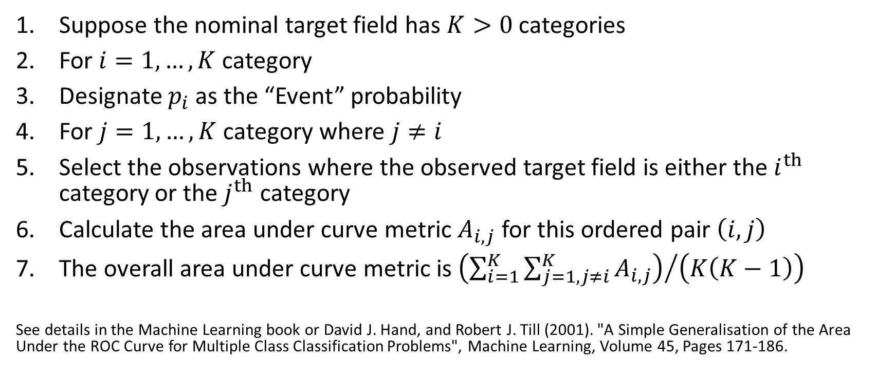
Area Under Curve for Nominal Target
Suppose the nominal target field has $K>0$ categories
For $i=1,…,K$ category
Designate $p_{i}$ as the “Event” probability
For $j=1,…,K$ category where $j≠i$
Select the observations where the observed target field is either the $i^{th}$ category or the $j^{th}$ category
Calculate the area under curve metric $A_{i,j}$ for this ordered pair $\left(i,j\right)$
The overall area under curve metric is ${\left(\sum_{i=1}^{K}{\sum_{j=1,j≠i}^{K}{A_{i,j}}}\right)}/{\left(K\left(K−1\right)\right)}$
See details in the Machine Learning book or David J. Hand, and Robert J. Till (2001). "A Simple Generalisation of the Area Under the ROC Curve for Multiple Class Classification Problems", Machine Learning, Volume 45, Pages 171-186.

Slide 39
Misclassification Rate for Nominal Target
Determine the predicted target category
e.g., the lexically lowest category which has the highest predicted probability
An observation is misclassified if the predicted target category is different from the observed target category.
Calculate the percents of observations that are misclassified.

Slide 40
Root Average Squared Error (RASE): Algorithm
RASE = $\sqrt{\frac{1}{nK}\sum_{i=1}^{n}{\sum_{j=1}^{K}{{\left(δ_{ij}−p_{ij}\right)}^{2}}}}$ where
n is the number of observations
K is the number of categories of the target variable
$p_{ij}$ is the predicted probability of the j^{th} target category for the i^{th} observation.
$δ_{ij}=1$ if the observed target value of the i^{th} observation matches the j^{th} target category, and 0 otherwise.
Theoretical range of RASE:
The minimum is zero when $p_{lj}=1$ for $δ_{ij}=1$, and $p_{lj}=0$ for $δ_{ij}=0$ (perfect model)
The maximum is one when one $p_{lj}=1$ for $δ_{ij}=0$, and $p_{lj}=0$ for $δ_{ij}=1$ (worst model)
The middle is ${\sqrt{K−1}}/K$when $p_{ij}=1/K$ (inconclusive model)
Acceptable model: RASE <${\sqrt{K−1}}/K$
Smaller the RASE below${\sqrt{K−1}}/K$, better the model.

Slide 41
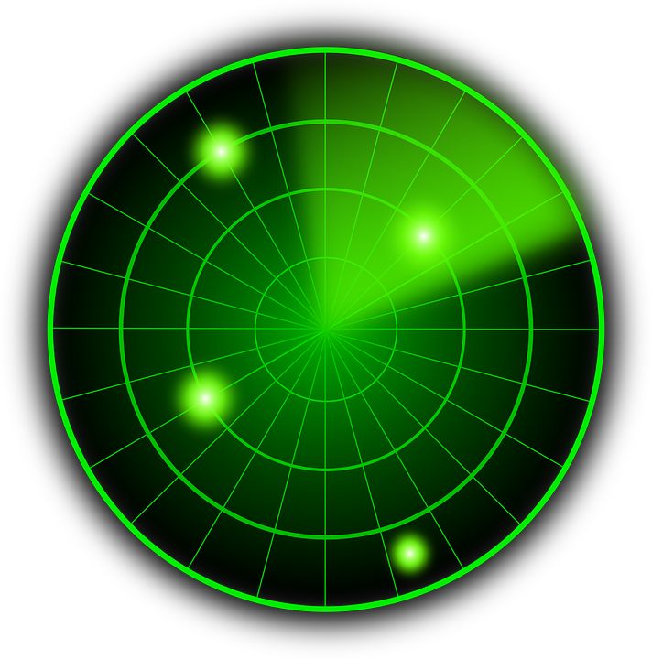
ROC Curve for Binary Target: Introduction
Introducing the “Curve” in the “Area Under Curve”.
The “Curve” is the Receiver Operating Characteristics (ROC) curve
ROC curves were developed in the 1950s as a by-product of research into making sense of radio signals contaminated by noise
After the 1941 Attack on Pearl Harbor, the United States Army began new research to increase the accuracy of detecting Japanese aircrafts from their radar signals
False Positive leads to weapon fire on airplanes from one's own side
False Negative leads to an actual enemy attack

Slide 42
ROC Curve: Motivations
If my model fits the data well, then an observed Event will also be predicted an Event most of the times.
However, predicting an Event depends on our threshold for the predicted Event probability.
The ROC curve can tell us how big that likelihood is over all possible choices of threshold.

Slide 43
ROC Curve: Focus on Predicting Event
 | Predicted Non-Event | Predicted Event | Total Observed
Observed Non-Event | A (true negative) | B (false positive) | A + B
Observed Event | C (false negative) | D (true positive) | C + D
Total Predicted | A + C | B + D | A + B + C + D
True Positive Rate: Sensitivity = (D / (C + D))
False Positive Rate: 1 – Specificity = (B / (A + B))
When the threshold goes down, then True Positive increases but False Positive also increases.
When the threshold goes up, then False Positive decreases but True Positive also decreases.
Our goal is to show the relationship between True Positive and False Positive for all possible thresholds.

Slide 44
ROC Curve: Construction
 | Predicted Non-Event | Predicted Event | Total Observed
Observed Non-Event | A (true negative) | B (false positive) | A + B
Observed Event | C (false negative) | D (true positive) | C + D
Total Predicted | A + C | B + D | A + B + C + D
Find Thresholds
Create a set of distinct values from the predicted event probabilities
Assign Event
Use each element of this set as a threshold to assign each observation into Predicted Event and Predicted Non-Event
Calculate Coordinates
Vertical Axis (True Positive Rate): Sensitivity = (D / (C + D))
Horizontal Axis (False Positive Rate): 1 – Specificity = (B / (A + B))
Assign an observation Predicted Event if Predicted Event Probability  Threshold

Slide 45
ROC Curve: Example
The set of distinct predicted event probabilities is: {0.2, 0.3, 0.4, 0.5, 0.7, 0.8, 0.9, 1.0}.
Number of Observed Event = 6
Number of Observed Non-Event = 5
Observed Target Value | Predicted Event Probability
Event | 0.9
Non-Event | 0.5
Non-Event | 0.3
Event | 0.7
Event | 0.3
Non-Event | 0.8
Event | 0.4
Non-Event | 0.2
Event | 1.0
Event | 0.5
Non-Event | 0.3

Slide 46
ROC Curve: Example
True Positive: Event
True Negative: Non-Event
Observed Target Value | Predicted Event Probability | Threshold: 0.2 | Threshold: 0.3 | Threshold: 0.4 | Threshold: 0.5 | Threshold: 0.7 | Threshold: 0.8 | Threshold: 0.9 | Threshold: 1.0
Non-Event | 0.2 | Event | Non-Event | Non-Event | Non-Event | Non-Event | Non-Event | Non-Event | Non-Event
Event | 0.3 | Event | Event | Non-Event | Non-Event | Non-Event | Non-Event | Non-Event | Non-Event
Non-Event | 0.3 | Event | Event | Non-Event | Non-Event | Non-Event | Non-Event | Non-Event | Non-Event
Non-Event | 0.3 | Event | Event | Non-Event | Non-Event | Non-Event | Non-Event | Non-Event | Non-Event
Event | 0.4 | Event | Event | Event | Non-Event | Non-Event | Non-Event | Non-Event | Non-Event
Event | 0.5 | Event | Event | Event | Event | Non-Event | Non-Event | Non-Event | Non-Event
Non-Event | 0.5 | Event | Event | Event | Event | Non-Event | Non-Event | Non-Event | Non-Event
Event | 0.7 | Event | Event | Event | Event | Event | Non-Event | Non-Event | Non-Event
Non-Event | 0.8 | Event | Event | Event | Event | Event | Event | Non-Event | Non-Event
Event | 0.9 | Event | Event | Event | Event | Event | Event | Event | Non-Event
Event | 1.0 | Event | Event | Event | Event | Event | Event | Event | Event
Threshold | 0.2 | 0.3 | 0.4 | 0.5 | 0.7 | 0.8 | 0.9 | 1
# TP | 6 | 6 | 5 | 4 | 3 | 2 | 2 | 1
# TN | 0 | 1 | 3 | 3 | 4 | 4 | 5 | 5
Sensitivity | 6/6=1.00 | 1.00 | 0.83 | 0.67 | 0.50 | 0.33 | 0.33 | 0.17
1 – Specificity | 1-0/5=1.00 | 0.80 | 0.40 | 0.40 | 0.20 | 0.20 | 0.00 | 0.00

Slide 47
ROC Curve: Example
Since the ROC Curve routinely includes the coordinates (0,0) and (1,1), you may need to add these two coordinates if they are not already there.
Threshold | 0.2 | 0.3 | 0.4 | 0.5 | 0.7 | 0.8 | 0.9 | 1
# TP | 6 | 6 | 5 | 4 | 3 | 2 | 2 | 1
# TN | 0 | 1 | 3 | 3 | 4 | 4 | 5 | 5
Sensitivity | 1.00 | 1.00 | 0.83 | 0.67 | 0.50 | 0.33 | 0.33 | 0.17
1 – Specificity | 1.00 | 0.80 | 0.40 | 0.40 | 0.20 | 0.20 | 0.00 | 0.00

Slide 48
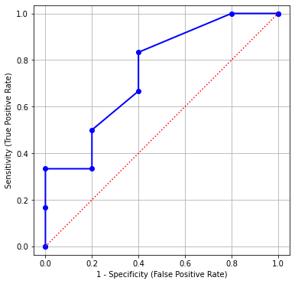
ROC Curve: Example
# Generate the coordinates for the ROC curve
fpr, tpr, thresholds = metrics.roc_curve(Y, predProbY,
pos_label = 'Event')
# Add two dummy coordinates
OneMinusSpecificity = numpy.append([0], fpr)
Sensitivity = numpy.append([0], tpr)
OneMinusSpecificity = numpy.append(OneMinusSpecificity, [1])
Sensitivity = numpy.append(Sensitivity, [1])
# Draw the ROC curve
plt.figure(figsize=(6,6))
plt.plot(OneMinusSpecificity, Sensitivity, marker = 'o',
color = 'blue', linestyle = 'solid', linewidth = 2, markersize = 6)
plt.plot([0, 1], [0, 1], color = 'red', linestyle = ':')
plt.grid(True)
plt.xlabel("1 - Specificity (False Positive Rate)")
plt.ylabel("Sensitivity (True Positive Rate)")
plt.axis("equal")
plt.show()

Slide 49
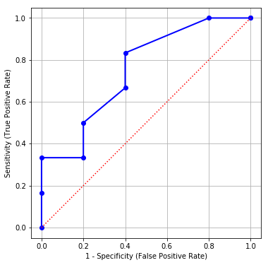
ROC Curve: Interpretations
If I can tolerate a particular percent of False Positive, then what percent of True Positive I will get?
If I can tolerate up to 10% of False Positive, then I can get up to 33% of True Positive (Sensitivity)
If I can tolerate up to 20% of False Positive, then I can get up to 50% of True Positive

Slide 50
ROC Curve: Interpretations
If I want a certain percent of True Positive, then what percent of False Positive do I need to tolerate?
If I want at least 80% of True Positive, then I need to tolerate at least 40% of False Positive (1 – Specificity)
If I want at least 40% of True Positive, then I need to tolerate at least 20% of False Positive

Slide 51
Kolmogorov-Smirnov Chart
Q: Can the ROC chart help us determine the probability cutoff?
Plot True Positive Rate and False Positive Rate versus Threshold
Identify the Threshold where the biggest gap between the two curves occur

Slide 52
Kolmogorov-Smirnov Chart
True Positive Rate is the Sensitivity
False Positive Rate is the 1 - Specificity
Threshold | 0.2 | 0.3 | 0.4 | 0.5 | 0.7 | 0.8 | 0.9 | 1
# TP | 6 | 6 | 5 | 4 | 3 | 2 | 2 | 1
# TN | 0 | 1 | 3 | 3 | 4 | 4 | 5 | 5
Sensitivity | 1.00 | 1.00 | 0.83 | 0.67 | 0.50 | 0.33 | 0.33 | 0.17
1 – Specificity | 1.00 | 0.80 | 0.40 | 0.40 | 0.20 | 0.20 | 0.00 | 0.00

Slide 53
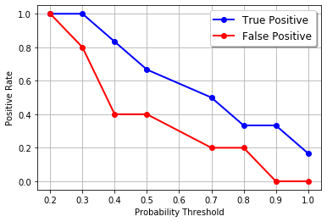
Kolmogorov-Smirnov Chart
# Draw the Kolmogorov Smirnov curve
cutoff = numpy.where(thresholds > 1.0, numpy.nan,
thresholds)
plt.plot(cutoff, tpr, marker = 'o’,
label = 'True Positive’,
color = 'blue', linestyle = 'solid')
plt.plot(cutoff, fpr, marker = 'o’,
label = 'False Positive',
color = 'red', linestyle = 'solid')
plt.grid(True)
plt.xlabel("Probability Threshold")
plt.ylabel("Positive Rate")
plt.legend(loc = 'upper right', shadow = True)
plt.show()

Slide 54
Kolmogorov-Smirnov Chart
The Kolmogorov Smirnov statistic is the largest difference between True Positive and False Positive.
The KS statistic is 0.43333333.
The largest difference happens when the probability threshold is 0.4.
This 0.4 value is one of the possible probability thresholds for declaring an Event.
What is the Misclassification Rate when the threshold is 0.4?

Slide 55
Gain and Lift: Statement of Problem
I built a model to predict a customer’s likelihood to respond to my market campaign
I should contact the customers who are more likely to respond according to the model
How should I choose the customers to contact?
What percentage of customers should I contact?
I have limited resources (e.g., budget, time)
What will be the response rate of the customers?

Slide 56
Gain and Lift: Motivations
If my model works, then the customers with higher predicted Event probabilities are more likely to respond than the customers with lower predicted Event probabilities.
An idea is to divide customers into groups of decreasing predicted Event probabilities and then study the response rates of these groups.
Ideally, the first few groups should contain the “more preferred” customers.

Slide 57
Gain and Lift: Algorithm
Score Model
Calculate the predicted event probabilities
Sort the probabilities in descending order
Create Deciles
Divide the probabilities into ten equal-count deciles
Calculate Statistics
Calculate the Response Rate, the Gain, and the Lift in each decile
Decile 1 contains the top 10% of predicted probabilities
Decile 10 contains the bottom 10% of predicted probabilities
Determine the actual count in each decile

Slide 58
Gain and Lift: Column Statistics
Decile N: Number of observations in the decile
Decile %: Percent of observations in the decile (base = all observations)
Gain N: Number of observations of the target Event category in the decile
Gain %: Percent of Event observations in the decile (base = all Event observations)
Response %: Percent of Event observations in the decile (based = observations in decile)
Lift: Response % divided by the overall percentage of the target category

Slide 59
Accumulated Gain and Lift: Column Statistics (Accumulated Decile = Lower Deciles + Current Decile)
Accumulated Decile N: Number of observations in the accumulated decile
Accumulated Decile %: Percent of observations in the accumulated decile (base = all observations)
Accumulated Gain N: Number of observations of the target Event category in the accumulated decile
Accumulated Gain %: Percent of Event observations in the accumulated decile (base = all Event observations)
Accumulated Response %: Percent of Event observations in the accumulated decile (based = observations in decile)
Accumulated Lift: accumulated response % divided by the overall percentage of the target category

Slide 60
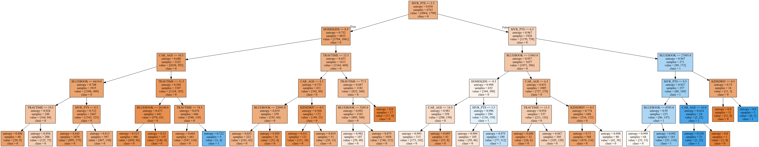
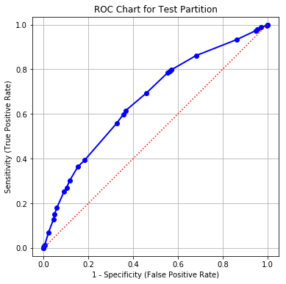
Gain and Lift: CART Model
Binary Target: CLAIM_FLAG Event category is 1 Non-Event category is 0
Interval Predictors: BLUEBOOK, CAR_AGE, HOMEKIDS, KIDSDRIV, MVR_PTS, and TRAVTIME
Training: 6,763 observations
Testing: 2,899 observations
Predicted Event Probability: pCLAIM_FLAG_1

Slide 61
Gain and Lift: CART Model on Test Partition
Decile | Decile N | Decile % | Gain N | Gain % | Response % | Lift
1 | 263 | 9.07 | 138 | 17.90 | 52.47 | 1.97
2 | 216 | 7.45 | 94 | 12.19 | 43.52 | 1.64
3 | 214 | 7.38 | 71 | 9.21 | 33.18 | 1.25
4 | 431 | 14.87 | 127 | 16.47 | 29.47 | 1.11
5 | 130 | 4.48 | 44 | 5.71 | 33.85 | 1.27
6 | 259 | 8.93 | 61 | 7.91 | 23.55 | 0.89
7 | 317 | 10.93 | 80 | 10.38 | 25.24 | 0.95
8 | 283 | 9.76 | 49 | 6.36 | 17.31 | 0.65
9 | 441 | 15.21 | 55 | 7.13 | 12.47 | 0.47
10 | 345 | 11.90 | 52 | 6.74 | 15.07 | 0.57
Overall | 2899 | 100.00 | 771 | 100.00 | 26.60 | 1

Slide 62
Gain and Lift: CART Model on Test Partition
Decile | Decile N | Decile % | Gain N | Gain % | Response % | Lift
1 | 263 | 9.07 | 138 | 17.90 | 52.47 | 1.97
2 | 216 | 7.45 | 94 | 12.19 | 43.52 | 1.64
3 | 214 | 7.38 | 71 | 9.21 | 33.18 | 1.25
4 | 431 | 14.87 | 127 | 16.47 | 29.47 | 1.11
5 | 130 | 4.48 | 44 | 5.71 | 33.85 | 1.27
6 | 259 | 8.93 | 61 | 7.91 | 23.55 | 0.89
7 | 317 | 10.93 | 80 | 10.38 | 25.24 | 0.95
8 | 283 | 9.76 | 49 | 6.36 | 17.31 | 0.65
9 | 441 | 15.21 | 55 | 7.13 | 12.47 | 0.47
10 | 345 | 11.90 | 52 | 6.74 | 15.07 | 0.57
Overall | 2899 | 100.00 | 771 | 100.00 | 26.60 | 1
138 observations with Response = 1 in Decile 1
138/771 = 17.90%
138 / 263 = 52.47%
52.47 / 26.60 = 1.97

Slide 63
Gain and Lift
# The Gain and Lift function
def compute_lift_coordinates (
DepVar, # The column that holds the dependent variable's values
EventValue, # Value of the dependent variable that indicates an event
EventPredProb, # The column that holds the predicted event probability
Debug = 'N'): # Show debugging information (Y/N)
# Find out the number of observations
nObs = len(DepVar)
# Get the quantiles
quantileCutOff = numpy.percentile(EventPredProb, numpy.arange(0, 100, 10))
nQuantile = len(quantileCutOff)
quantileIndex = numpy.zeros(nObs)
for i in range(nObs):
iQ = nQuantile
EPP = EventPredProb[i]
for j in range(1, nQuantile):
if (EPP > quantileCutOff[-j]):
iQ -= 1
quantileIndex[i] = iQ

Slide 64
Gain and Lift
# Construct the Lift chart table
countTable = pandas.crosstab(quantileIndex, DepVar)
decileN = countTable.sum(1)
decilePct = 100 * (decileN / nObs)
gainN = countTable[EventValue]
totalNResponse = gainN.sum(0)
gainPct = 100 * (gainN /totalNResponse)
responsePct = 100 * (gainN / decileN)
overallResponsePct = 100 * (totalNResponse / nObs)
lift = responsePct / overallResponsePct
LiftCoordinates = pandas.concat([decileN, decilePct, gainN, gainPct, responsePct, lift],
axis = 1, ignore_index = True)
LiftCoordinates = LiftCoordinates.rename({0:'Decile N',
1:'Decile %',
2:'Gain N',
3:'Gain %',
4:'Response %',
5:'Lift'}, axis = 'columns')

Slide 65
Gain and Lift
# Construct the Accumulative Lift chart table
accCountTable = countTable.cumsum(axis = 0)
decileN = accCountTable.sum(1)
decilePct = 100 * (decileN / nObs)
gainN = accCountTable[EventValue]
gainPct = 100 * (gainN / totalNResponse)
responsePct = 100 * (gainN / decileN)
lift = responsePct / overallResponsePct
accLiftCoordinates = pandas.concat([decileN, decilePct, gainN, gainPct, responsePct, lift],
axis = 1, ignore_index = True)
accLiftCoordinates = accLiftCoordinates.rename({0:'Acc. Decile N',
1:'Acc. Decile %',
2:'Acc. Gain N',
3:'Acc. Gain %',
4:'Acc. Response %',
5:'Acc. Lift'}, axis = 'columns')
return(LiftCoordinates, accLiftCoordinates)

Slide 66
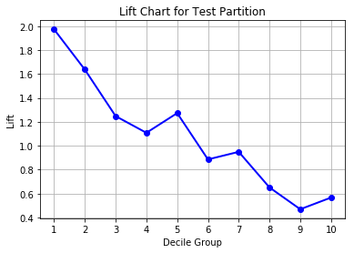
Gain and Lift: Interpretation
If we only contact the top 10% of customers, then 52.47% of them will respond. This response rate is 1.97 times the overall rate.
If we only contact the next 10% of customers, then 43.52% of them will respond. This response rate is 1.64 times the overall rate.
Decile | Decile N | Decile % | Gain N | Gain % | Response % | Lift
1 | 263 | 9.07 | 138 | 17.90 | 52.47 | 1.97
2 | 216 | 7.45 | 94 | 12.19 | 43.52 | 1.64
3 | 214 | 7.38 | 71 | 9.21 | 33.18 | 1.25
4 | 431 | 14.87 | 127 | 16.47 | 29.47 | 1.11
5 | 130 | 4.48 | 44 | 5.71 | 33.85 | 1.27
6 | 259 | 8.93 | 61 | 7.91 | 23.55 | 0.89
7 | 317 | 10.93 | 80 | 10.38 | 25.24 | 0.95
8 | 283 | 9.76 | 49 | 6.36 | 17.31 | 0.65
9 | 441 | 15.21 | 55 | 7.13 | 12.47 | 0.47
10 | 345 | 11.90 | 52 | 6.74 | 15.07 | 0.57
Overall | 2899 | 100.00 | 771 | 100.00 | 26.60 | 1

Slide 67
Accumulated Gain and Lift: CART Model on Test Partition
Decile | Acc. Decile N | Acc. Decile % | Acc. Gain N | Acc. Gain % | Acc. Response % | Acc. Lift
1 | 263 | 9.07 | 138 | 17.90 | 52.47 | 1.97
2 | 479 | 16.52 | 232 | 30.09 | 48.43 | 1.82
3 | 693 | 23.90 | 303 | 39.30 | 43.72 | 1.64
4 | 1124 | 38.77 | 430 | 55.77 | 38.26 | 1.44
5 | 1254 | 43.26 | 474 | 61.48 | 37.80 | 1.42
6 | 1513 | 52.19 | 535 | 69.39 | 35.36 | 1.33
7 | 1830 | 63.13 | 615 | 79.77 | 33.61 | 1.26
8 | 2113 | 72.89 | 664 | 86.12 | 31.42 | 1.18
9 | 2554 | 88.10 | 719 | 93.26 | 28.15 | 1.06
10 | 2899 | 100.00 | 771 | 100.00 | 26.60 | 1.00
Overall | 2899 | 100.00 | 771 | 100.00 | 26.60 | 1

Slide 68
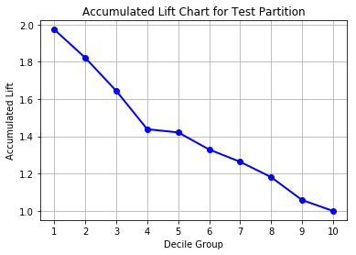
Accumulated Gain and Lift: Interpretation
If we only contact the top 20% of customers, then 48.43% of them will respond. This response rate is 1.82 times the overall rate.
If we only contact the top 30% of customers, then 43.72% of them will respond. This response rate is 1.64 times the overall rate.
Decile | Acc. Decile N | Acc. Decile % | Acc. Gain N | Acc. Gain % | Acc. Response % | Acc. Lift
1 | 263 | 9.07 | 138 | 17.90 | 52.47 | 1.97
2 | 479 | 16.52 | 232 | 30.09 | 48.43 | 1.82
3 | 693 | 23.90 | 303 | 39.30 | 43.72 | 1.64
4 | 1124 | 38.77 | 430 | 55.77 | 38.26 | 1.44
5 | 1254 | 43.26 | 474 | 61.48 | 37.80 | 1.42
6 | 1513 | 52.19 | 535 | 69.39 | 35.36 | 1.33
7 | 1830 | 63.13 | 615 | 79.77 | 33.61 | 1.26
8 | 2113 | 72.89 | 664 | 86.12 | 31.42 | 1.18
9 | 2554 | 88.10 | 719 | 93.26 | 28.15 | 1.06
10 | 2899 | 100.00 | 771 | 100.00 | 26.60 | 1.00
Overall | 2899 | 100.00 | 771 | 100.00 | 26.60 | 1

Slide 69
Gain and Lift: Goals
Gain %
Percent of Event category captured in entire data
Ideally, like to see decreasing Gain % down the deciles
Response %
Percent of Event category capture in a decile
Ideally, like to see decreasing Response % down the deciles
Lift
Compare Response % in a decile to that in entire data
Higher than one is always better

Slide 70
Gain and Lift: Decision Flow
Resources
Maximum percent of customers we can contact
Take Accumulated Decile k?
Starting from Accumulated Decile 1
Have resources to take this Accumulated Decile?
Good Enough Lift?
Subjectively decide if this Accumulated Lift is high enough?

Slide 71
Precision and Recall Curve: Motivation
I built a model to predict a customer’s likelihood to respond to my market campaign
I need a model that will predict YES to customers who are observed YES with high accuracy
Push the percent of True Positive up
Keep the percent of False Positive under control
I am not too concerned about the accuracy of the predictions to the “NO” customers
Do not worry about the True Negative

Slide 72
Precision and Recall Curve: Definitions
 | Predicted Non-Event | Predicted Event | Total Observed
Observed Non-Event | A (true negative) | B (false positive) | A + B
Observed Event | C (false negative) | D (true positive) | C + D
Total Predicted | A + C | B + D | A + B + C + D
Precision = (D / (B + D))
The fraction of True Positive observations out of the Predicted Event observations
Also known as Positive Predictive Value
The conditional probability Pr(Observed is Event | Predicted is Event)
Recall = (D / (C + D))
The fraction of True Positive observations out of the Observed Event observations
Same as the Sensitivity metric
The conditional probability Pr(Predicted is Event | Observed is Event)

Slide 73
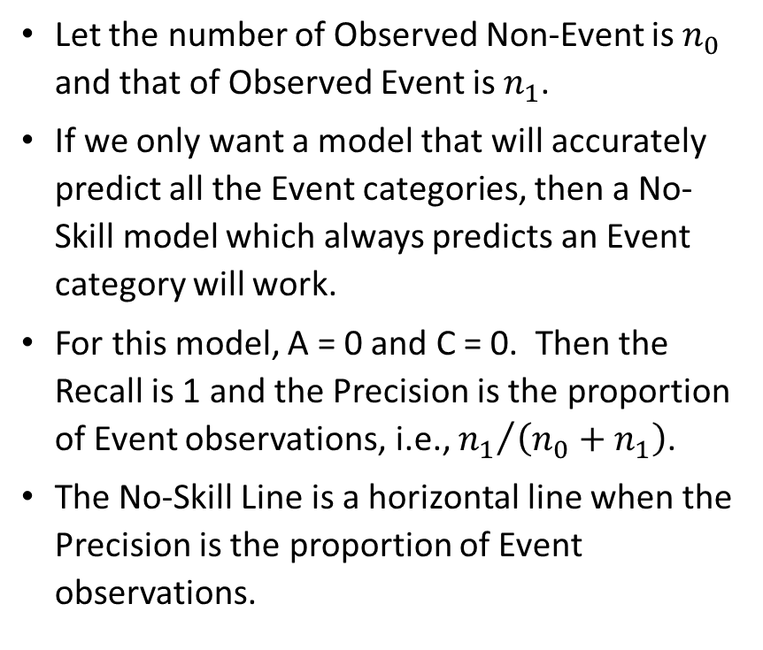
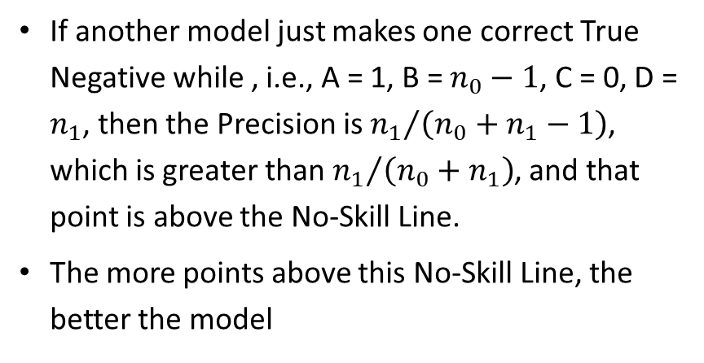
Precision and Recall Curve: No-Skill Line
Let the number of Observed Non-Event is $n_{0}$ and that of Observed Event is $n_{1}$.
If we only want a model that will accurately predict all the Event categories, then a No-Skill model which always predicts an Event category will work.
For this model, A = 0 and C = 0. Then the Recall is 1 and the Precision is the proportion of Event observations, i.e., ${n_{1}}/{\left(n_{0}+n_{1}\right)}$.
The No-Skill Line is a horizontal line when the Precision is the proportion of Event observations.
 | Predicted Non-Event | Predicted Event | Total Observed
Observed Non-Event | A (true negative) | B (false positive) | A + B
Observed Event | C (false negative) | D (true positive) | C + D
Total Predicted | A + C | B + D | A + B + C + D
If another model just makes one correct True Negative while , i.e., A = 1, B = $n_{0}−1$, C = 0, D = $n_{1}$, then the Precision is ${n_{1}}/{\left(n_{0}+n_{1}−1\right)}$, which is greater than ${n_{1}}/{\left(n_{0}+n_{1}\right)}$, and that point is above the No-Skill Line.
The more points above this No-Skill Line, the better the model

Slide 74
Precision and Recall Curve: Construction
Find Thresholds
Create a set of distinct values from the predicted event probabilities
Assign Event
Use each element of this set as a threshold to assign each observation into Predicted Event and Predicted Non-Event
Calculate Coordinates
Horizontal Axis: Sensitivity = (D / (C + D))
Assign an observation Predicted Event if Predicted Event Probability  Threshold
Vertical Axis: Precision = (D / (B + D))
 | Predicted Non-Event | Predicted Event | Total Observed
Observed Non-Event | A (true negative) | B (false positive) | A + B
Observed Event | C (false negative) | D (true positive) | C + D
Total Predicted | A + C | B + D | A + B + C + D

Slide 75
Precision and Recall Curve: Example
The set of distinct predicted event probabilities is: {0.2, 0.3, 0.4, 0.5, 0.7, 0.8, 0.9, 1.0}.
Number of Observed Event = 6
Number of Observed Non-Event = 5
The No-Skill Line is 6/(6+5) = 6/11 = 0.55
Observed Target Value | Predicted Event Probability
Event | 0.9
Non-Event | 0.5
Non-Event | 0.3
Event | 0.7
Event | 0.3
Non-Event | 0.8
Event | 0.4
Non-Event | 0.2
Event | 1.0
Event | 0.5
Non-Event | 0.3

Slide 76
Precision and Recall Curve: Example
True Positive: Event
True Negative: Non-Event
Observed Target Value | Predicted Event Probability | Threshold: 0.2 | Threshold: 0.3 | Threshold: 0.4 | Threshold: 0.5 | Threshold: 0.7 | Threshold: 0.8 | Threshold: 0.9 | Threshold: 1.0
Non-Event | 0.2 | Event | Non-Event | Non-Event | Non-Event | Non-Event | Non-Event | Non-Event | Non-Event
Event | 0.3 | Event | Event | Non-Event | Non-Event | Non-Event | Non-Event | Non-Event | Non-Event
Non-Event | 0.3 | Event | Event | Non-Event | Non-Event | Non-Event | Non-Event | Non-Event | Non-Event
Non-Event | 0.3 | Event | Event | Non-Event | Non-Event | Non-Event | Non-Event | Non-Event | Non-Event
Event | 0.4 | Event | Event | Event | Non-Event | Non-Event | Non-Event | Non-Event | Non-Event
Event | 0.5 | Event | Event | Event | Event | Non-Event | Non-Event | Non-Event | Non-Event
Non-Event | 0.5 | Event | Event | Event | Event | Non-Event | Non-Event | Non-Event | Non-Event
Event | 0.7 | Event | Event | Event | Event | Event | Non-Event | Non-Event | Non-Event
Non-Event | 0.8 | Event | Event | Event | Event | Event | Event | Non-Event | Non-Event
Event | 0.9 | Event | Event | Event | Event | Event | Event | Event | Non-Event
Event | 1.0 | Event | Event | Event | Event | Event | Event | Event | Event
Threshold | 0.2 | 0.3 | 0.4 | 0.5 | 0.7 | 0.8 | 0.9 | 1
# TP | 6 | 6 | 5 | 4 | 3 | 2 | 2 | 1
# TN | 0 | 1 | 3 | 3 | 4 | 4 | 5 | 5
Precision | 6/11=0.55 | 6/10=0.60 | 5/7=0.71 | 4/6=0.67 | 3/4=0.75 | 2/3=0.67 | 2/2=1.00 | 1/1=1.00
Recall | 6/6=1.00 | 6/6=1.00 | 5/6=0.83 | 4/6=0.67 | 3/6=0.50 | 2/6=0.33 | 2/6=0.33 | 1/6=0.17

Slide 77
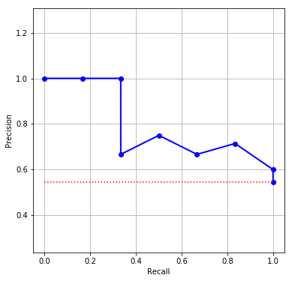
Precision and Recall Curve: Example
Threshold | 0.2 | 0.3 | 0.4 | 0.5 | 0.7 | 0.8 | 0.9 | 1
# TP | 6 | 6 | 5 | 4 | 3 | 2 | 2 | 1
# TN | 0 | 1 | 3 | 3 | 4 | 4 | 5 | 5
Precision | 0.55 | 0.60 | 0.71 | 0.67 | 0.75 | 0.67 | 1.00 | 1.00
Recall | 1.00 | 1.00 | 0.83 | 0.67 | 0.50 | 0.33 | 0.33 | 0.17
Note: Since the Precision and Recall routinely includes the point (0,1), you may need to add this point if they are not already there.
Finding: This model is good since all points, except the rightmost one, are above the No-Skill Line.

Slide 78
F1 Score
A perfect model will have Precision = 1 and Recall = 1.
We try to get the best Precision and the best Recall at the same time.
The F1 Score is the harmonic mean of Precision and Recall
Since the harmonic mean will substantially pull a large value down and push a small value up, a large F1 Score indicates that both Precision and Recall are relatively very large.
F1 Score = 1 / ((1 / Precision + 1 / Recall) / 2)
Plot the F1 Score (vertical axis) versus the Threshold (horizontal axis) to determine the optimal threshold that gives the best F1 Score.

Slide 79
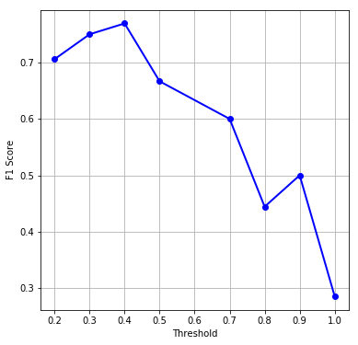

Precision and Recall Curve: Example
Threshold | 0.2 | 0.3 | 0.4 | 0.5 | 0.7 | 0.8 | 0.9 | 1
Precision | 0.55 | 0.60 | 0.71 | 0.67 | 0.75 | 0.67 | 1.00 | 1.00
Recall | 1.00 | 1.00 | 0.83 | 0.67 | 0.50 | 0.33 | 0.33 | 0.17
F1 Score | 0.71 | 0.75 | 0.77 | 0.67 | 0.60 | 0.44 | 0.50 | 0.29
Finding: The F1 Score attains its maximum when the threshold is 0.4.
With this threshold, the Sensitivity is 0.83 and the 1 – Specificity is 0.40.
The False Positive Rate is 40% and the True Positive Rate is 83%.
With this threshold, the Misclassification Rate is 3/11 = 0.2727

Slide 80
Lecture Recap
Interval Target
Relative Error
Root Average Squared Error
Binary Target
Area Under Curve
Root Average Squared Error
Misclassification Rate
F1 Score
Receiver Operating Characteristic Curve
Lift Curve
Kolmogorov-Smirnov Curve
Precision-Recall Curve
Nominal Target
Area Under Curve
Root Average Squared Error
Misclassification Rate

